Slide 1

Elm SPA Navigation
Dividing a SPA
Navigation and the URL
Per Lundholm Crisp
Notes:
Nivå på talet
Vem är jag
Vad gör jag nu

Slide 2
Agenda
Problem statement
Demo
Divide an application into page modules
Handle browser location

Slide 3
Problem statement
How can I structure my Elm app so that:
Each page has Model, Messages, Update and View?
Browser’s location bar is updated
Back and forward works
Bookmarking possible
But an Elm app has only one source of truth
One Model
One Update
One View
Notes:
You start with Main
Model, Message, View, Update
Easy no navigation
Then?

Slide 4
Example Application
Book collection
Pages
Home page
Listing page
Lists books
Details page
Details about a selected book

Slide 5
Demo
Notes:
http://localhost:3005

Slide 6
Dividing into Modules
Home Page
Msg = …
Model = …
init = …
update = …
view = …
Main
Msg = …
Model = …
main = …
init = …
update = …
view = …
Listing Page
Msg = …
Model = …
init = …
update = …
view = …
Router
Msg = …
Model = …
init = …
update = …
view = …
Details Page
Msg = …
Model = …
init = …
update = …
view = …

Slide 7
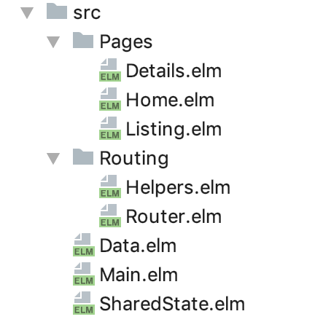
Source structure

Slide 8
Dividing the Model
The Model can only be one, the Main model
The Main model contains the Router model
The Router model contains the page’s models.
Main.elm
Router.elm
type alias Model = { navKey : Browser.Navigation.Key , url : Url , sharedState : SharedState.SharedState , routerModel : Routing.Router.Model }
type alias Model = { route : Routing.Helpers.Route , homeModel : Pages.Home.Model , listingModel : Pages.Listing.Model , detailsModel : Pages.Details.Model }
Details.elm
type DetailsModel = Initial | NotFound | Loaded Data.Book
type alias Model = { details : DetailsModel }

Slide 9
Delegating the update
The update function takes a message and a model and returns a new model plus a command
update: Msg -> Model -> ( Model, Cmd Msg )
We need to delegate the job
Main to Router to Page
But how? Main shouldn’t know about page’s Msg!
Answer: Cmd.map

Slide 10
Cmd.map
Details
Router
Main
fn BookLoaded
Cmd.map DetailMsg (fn BookLoaded)
BookLoaded
Cmd.map RouterMsg (DetailMsg (fn BookLoaded))
DetailMsg (BookLoaded)
RouterMsg (DetailMsg (BookLoaded))

Slide 11
Navigation

Slide 12

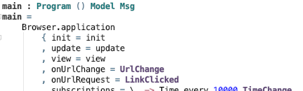

Managing Browser Location
How do we get Urls like:
We use Browser.Navigation of elm/browser!
Step 1. Declare messages for Url changes

Slide 13
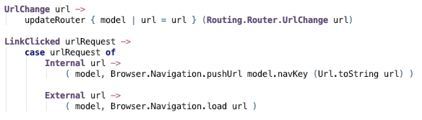
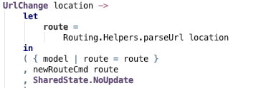
Step 2: Handle the messages
Main
Router

Slide 14

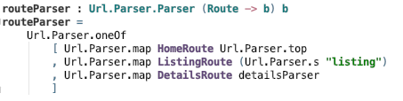

Step 3: Parse the Url

Slide 15
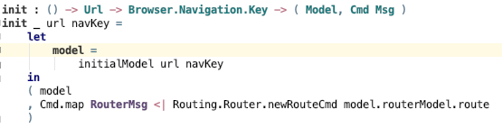
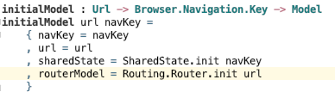
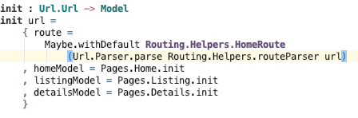
Step 4: Enable bookmarking by parsing at init
Main
Router init

Slide 16
Summary
Divide app into modules for each page
Delegate update to pages and use Cmd.map
With elm/browser package handle browser location so that
Back and forward works
Bookmarking possible

Slide 17
Source
Source code for the demo
https://github.com/perty/elm-navigation-test
Ossi Hanhinen’s Shared state
https://github.com/ohanhi/elm-shared-state
Elm’s Browser Navigation
https://package.elm-lang.org/packages/elm/browser/latest/Browser-Navigation
Thank you!

